Slide 1




Esaltare Dekör
Graduation Project 2025
Computer Science Department
Under supervision :
Dr.Shadia Sarhan
Eng.Nada Adel
Team Leader: Ziad Essam Abdelaziz AbdelMoula

Slide 2




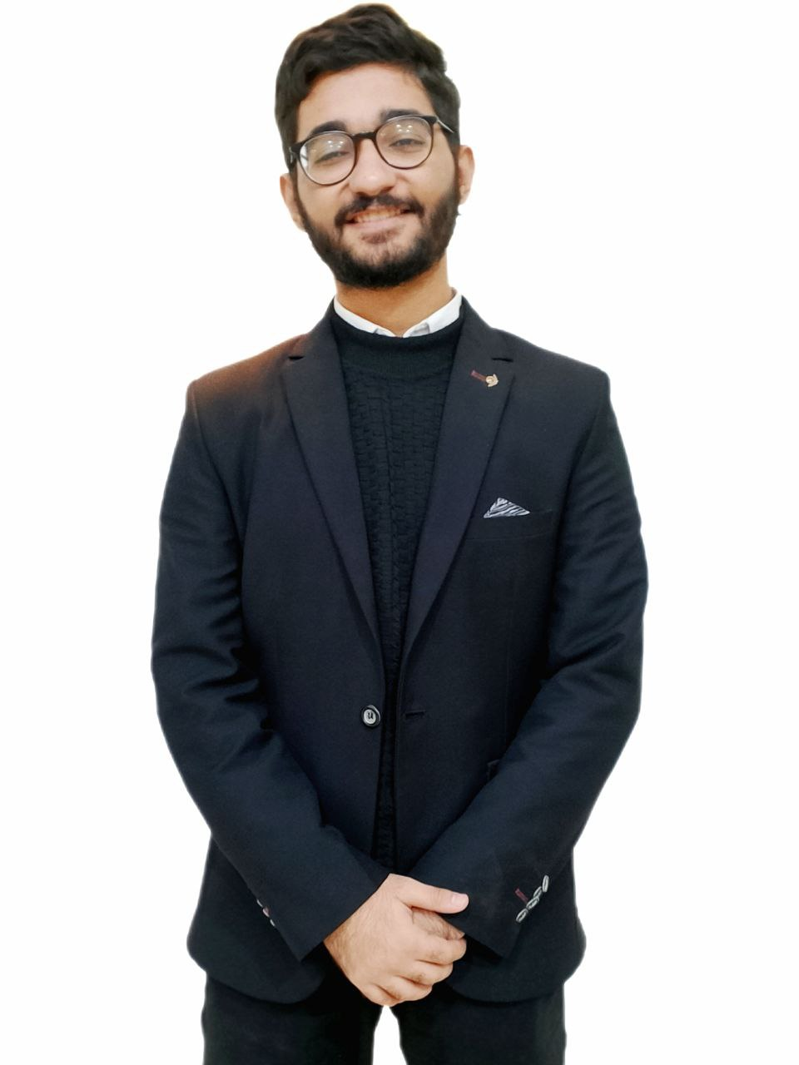
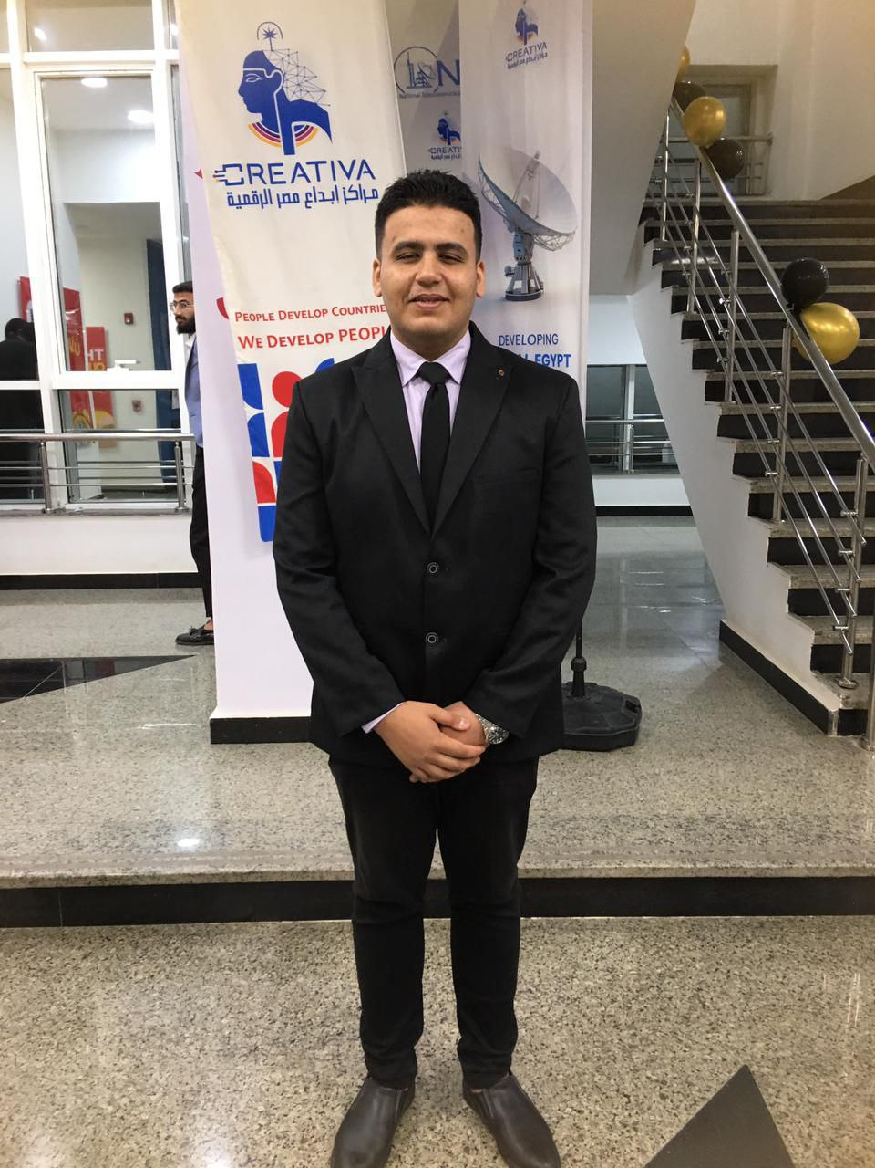
Team Members
Ziad
Saad
Karim
Shimaa
Baraa

Slide 3
Agenda
Problem
Exiting solutions
Brief overview of Esaltare Dekör
Chatbot Integration
Administration
Esaltare Dekör 3D Designer Tools
Results

Slide 4
1. Problem

Slide 5
Problem
The main challenges in home decor and interior design are the difficulties many people face in making the right decisions. This often leads to prolonged periods of indecision and time wastage, as individuals struggle to choose styles and elements that truly reflect their personalities.
Additionally, a lack of long-term self-understanding can result in confusion and hesitation, making it even harder to select decor that will remain satisfying and meaningful over time.
Many online shoppers struggle to find products that match their preferences and needs, leading to frustration and wasted time. Additionally, users often cannot visualize how products will look in their own spaces.

Slide 6
Problem
This project aims to address these issues by providing personalized and sustainable solutions that help individuals make confident and informed choices for their living spaces.

Slide 7
2. Exiting solutions

Slide 8




Exiting solutions
IKEA Egypt
Homzmart
La Casa

Slide 9


Exiting solutions
Magali's
TULIP

Slide 10

Real World Example Of Startups
You can deceive anyone by lowering the price of your product, but what is your product made of or where does it come from? This is a major disaster that you bring used products and pretend to the user that they are real or new products. Then comes the lies and lack of trust in not respecting the customer, and there come workshops to work on repairing damaged products and displaying them as new products. This is a major disaster.
7agat

Slide 11
Exiting solutions Problems
Lack of Integrated Personality-Based Recommendations:
Limited AI Chatbot Capabilities.
Absence of an Interactive Shopping Experience
Lying and fraud in marketing

Slide 12
3. Brief overview of Esaltare Dekör

Slide 13
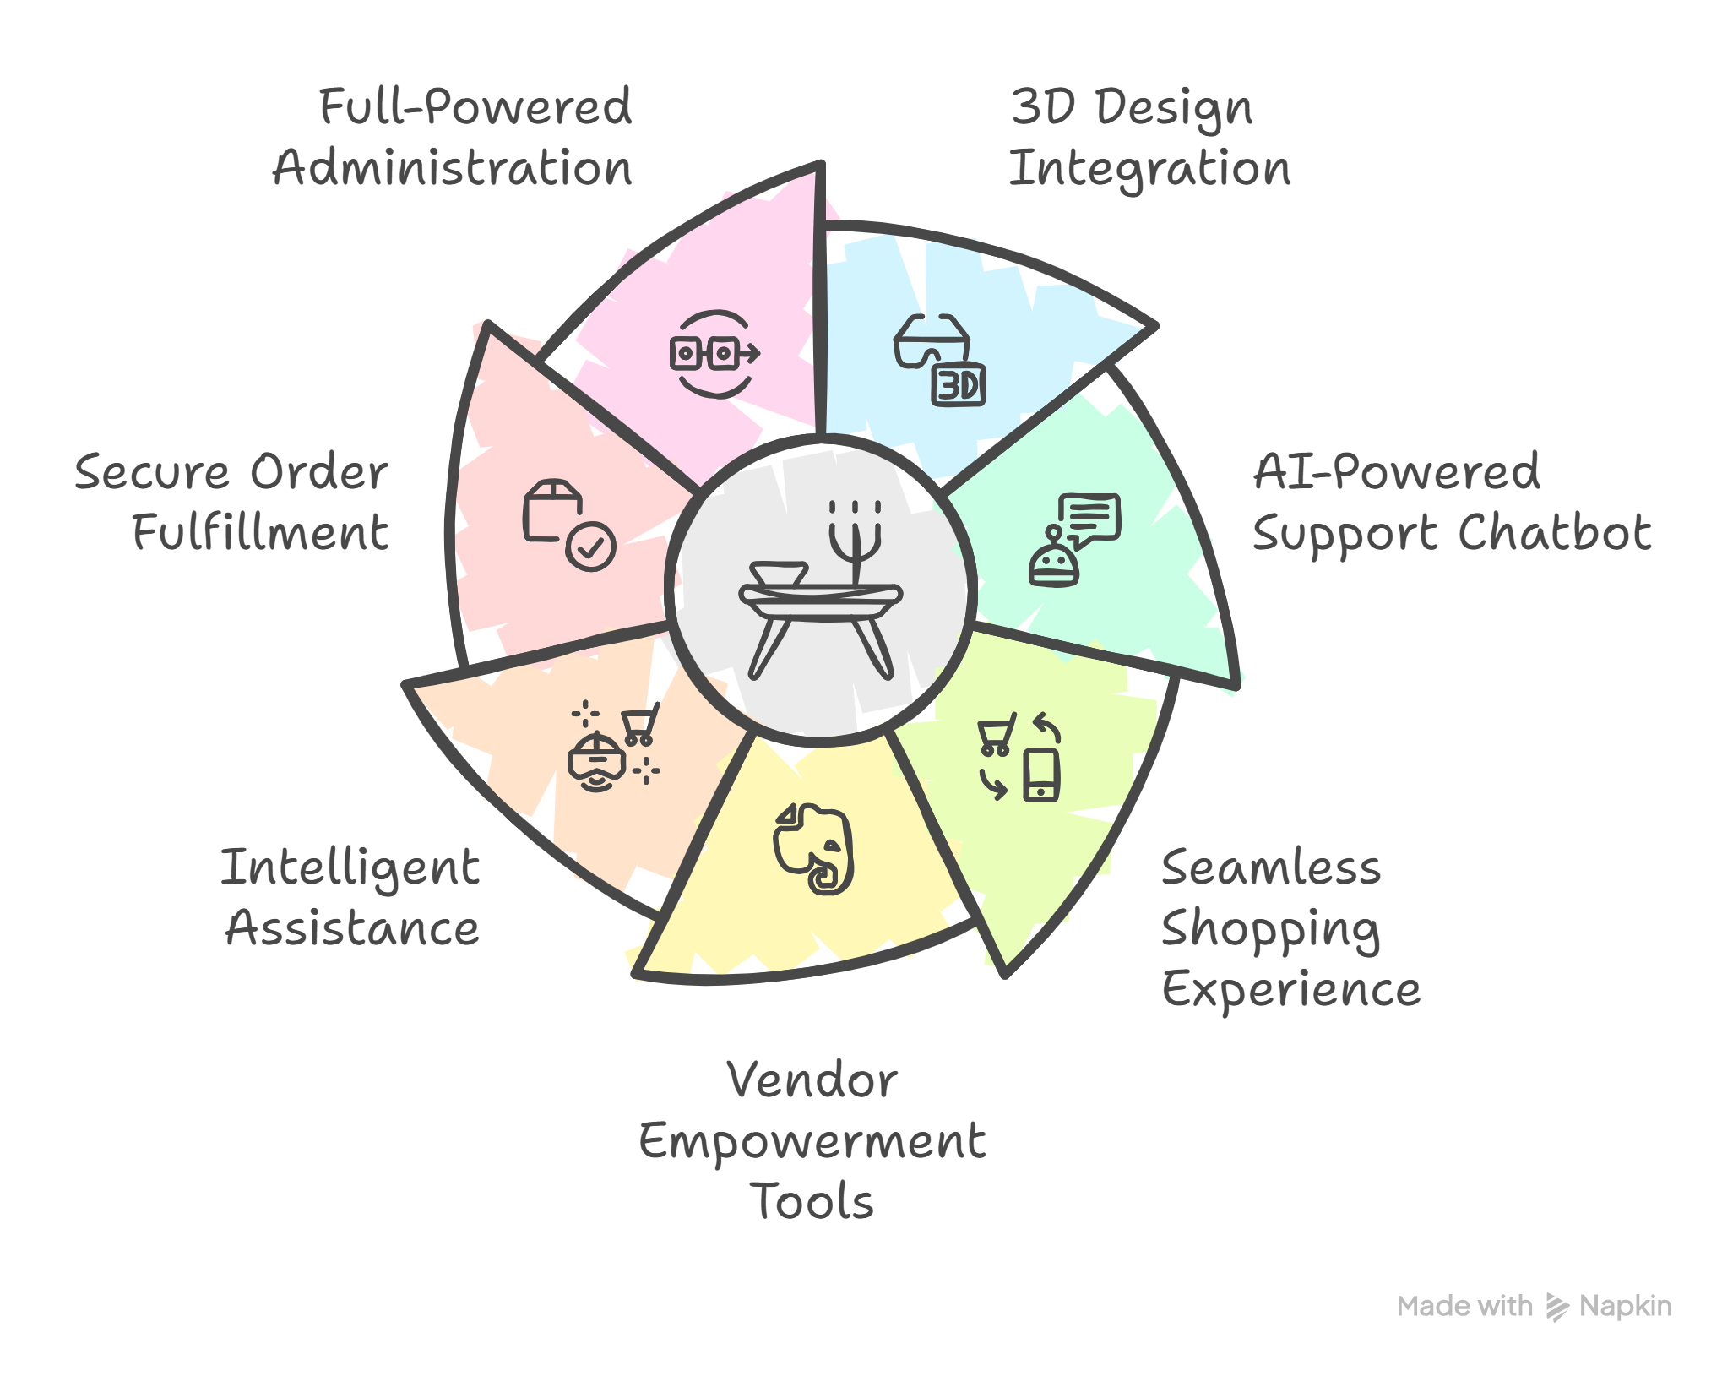
Brief overview of Esaltare Dekör
Esaltare Dekör is an online e-commerce platform tailored for the home decor industry, offering an enhanced and interactive shopping experience.
A key feature is the integration of advanced 3D Design
AI-powered support chatbot
Deliver seamless shopping experience
Empower vendors with tools and Packages
Enable intelligent assistance
Ensure secure order fulfillment
Full Powered Administration

Slide 14
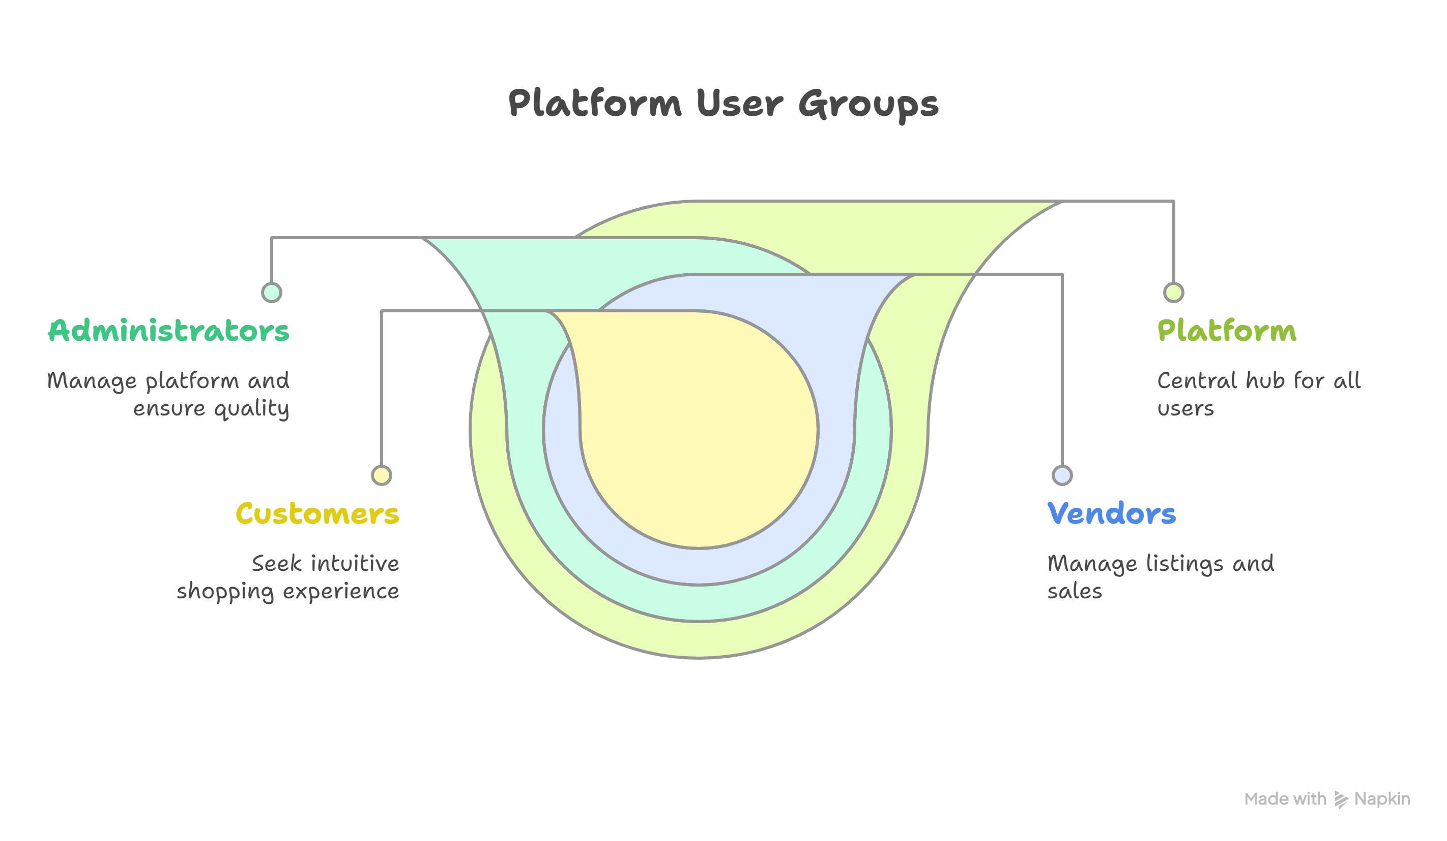
Brief overview of Esaltare Dekör
Esaltare Dekör Core Our platform is designed to serve three core user groups:
Customers : who seek an intuitive and tailored shopping experience
Vendors : who need efficient tools to manage product listings and sales operations
Administrators: who require robust systems for platform management, analytics, and quality assurance.

Slide 15





Esaltare Dekör System Architecture
Chatbot
Admin
Backend
Client
User
Vendor
Database
database queries

Slide 16
4. Chatbot Integration

Slide 17
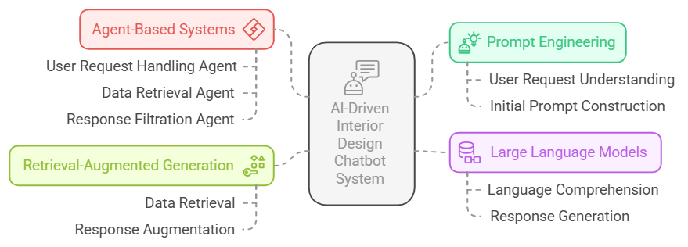
Chatbot Integration

Slide 18
Chatbot Integration
Large Language Models (LLMs): Foundation for advanced AI applications.
1. Prompt Engineering: Guide your chatbot with precise instructions.
2. Retrieval-Augmented Generation (RAG): Enhance chatbot answers using personalized data.
3. Agent-Based Systems: Create specialized components for efficient and accurate chatbot responses.
4. Market Basket Analysis Recommendation Engine: Build a recommendation engine from scratch.

Slide 19
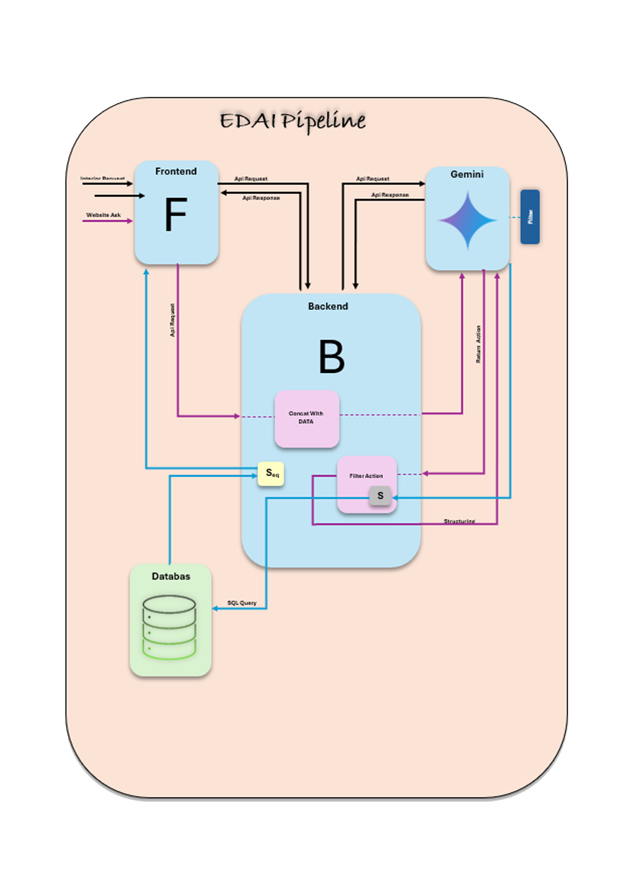
AI Model Architecture EDAI

Slide 20
5. Administration

Slide 21
Administration
Admin is the central control system responsible for overseeing, managing, and optimizing all core operations of a platform and there is some of its operations :
Product Management
Categories and Subcategories Manage
Products Manage
Brands and Order Management
Vendor Management
Announcement Management

Slide 22
6. Dekör 3D Designer Tools

Slide 23
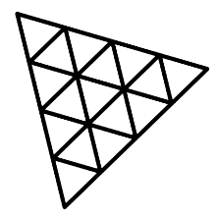
Esaltare Dekör 3D Designer Tools
The 3D design tool enables the user to enter a virtual world where he can interact with complete structures by taking the 3D designs and placing them in a suitable place to match the appropriate decorations with
Key Features:
Model Management Panel: View, select, or delete models from the scene. Rename or categorize elements for better organization.
Dimensional Control :Adjust width, height, and depth interactively. Scale objects to fit space accurately using sliders or direct numeric input.
Technologies Used:
React.js – for building the user interface
React Three Fiber – for rendering and managing 3D scenes in the browser
Three.js – for low-level 3D graphics and geometry control

Slide 24
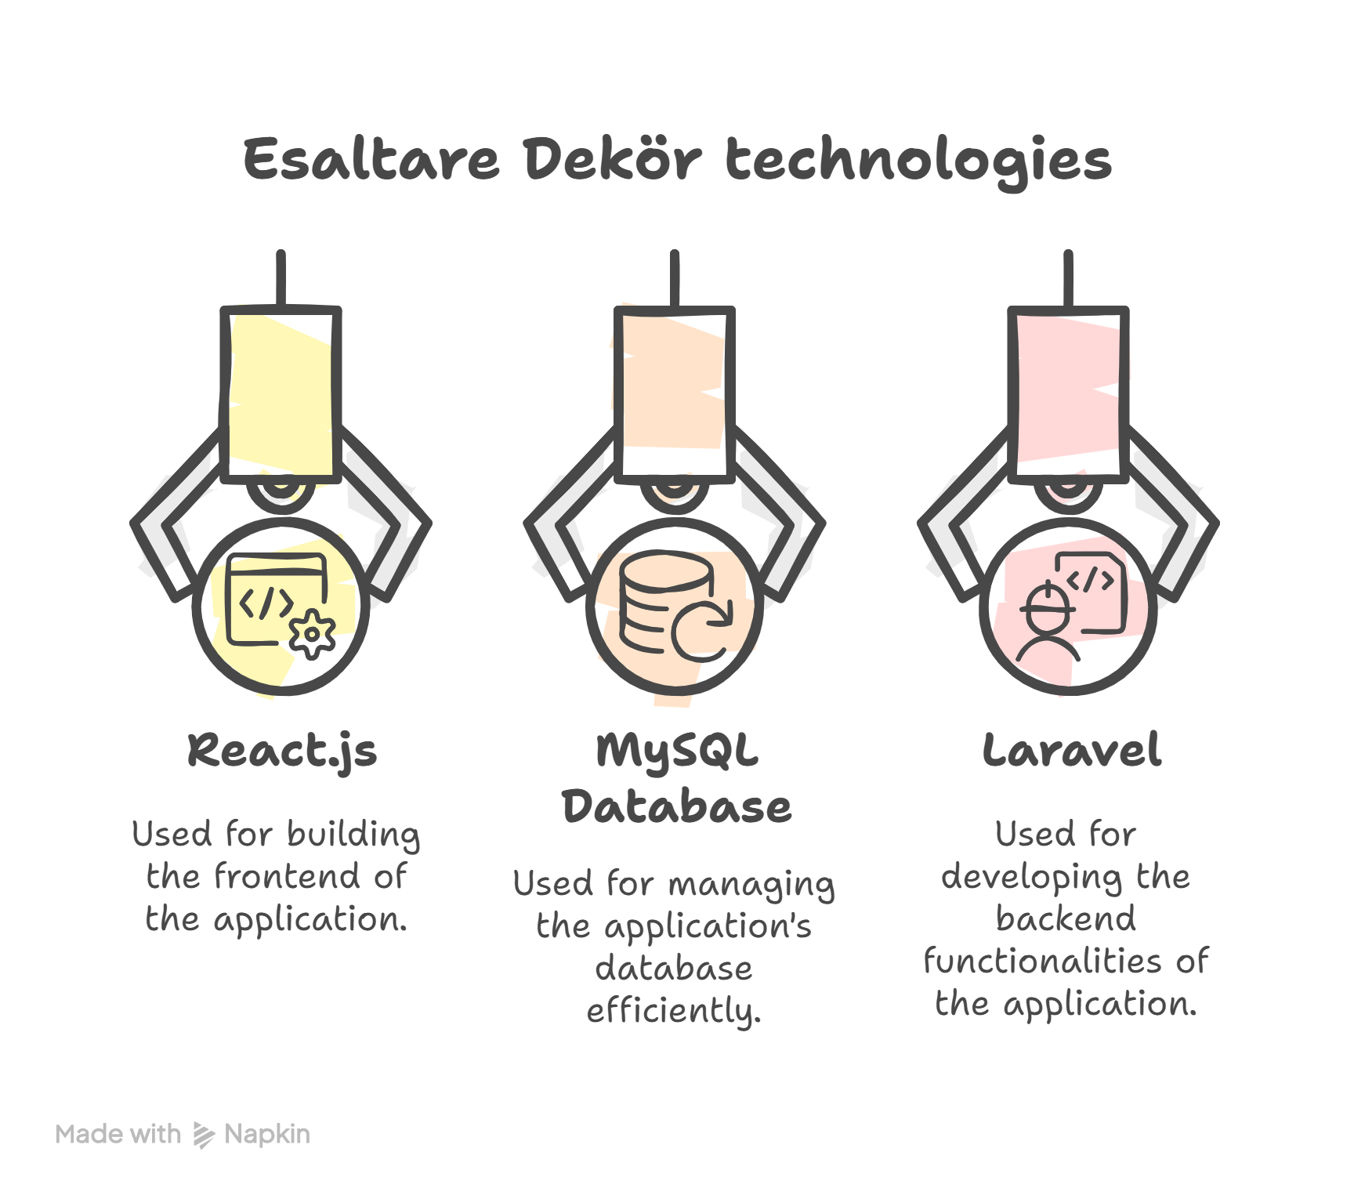




Esaltare Dekör Technologies used
Esaltare Dekör is built using the following technologies:
React.js: For frontend development.
MySQL Database : For database management.
Laravel : For backend development

Slide 25
7.Results

Slide 26

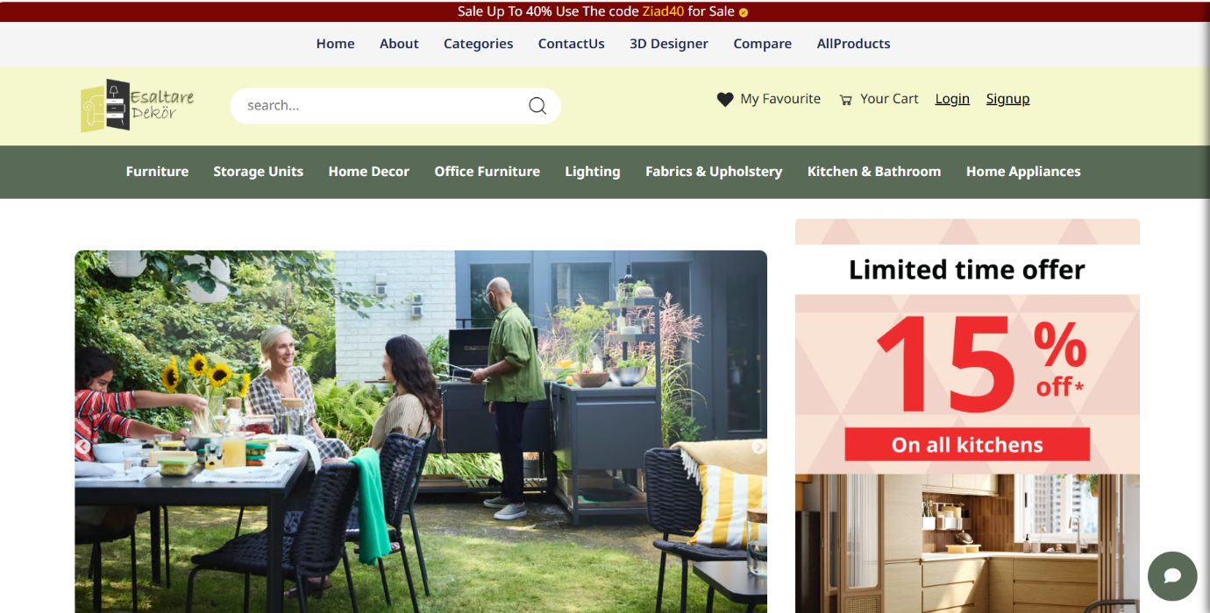

Slide 27
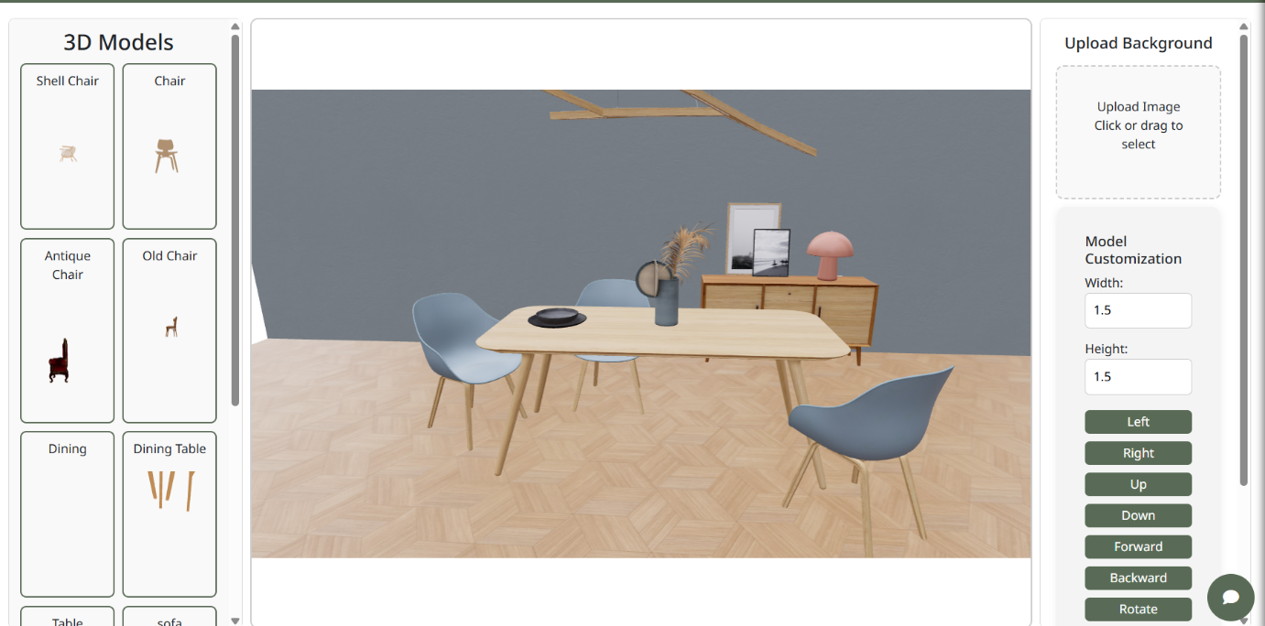

Slide 28
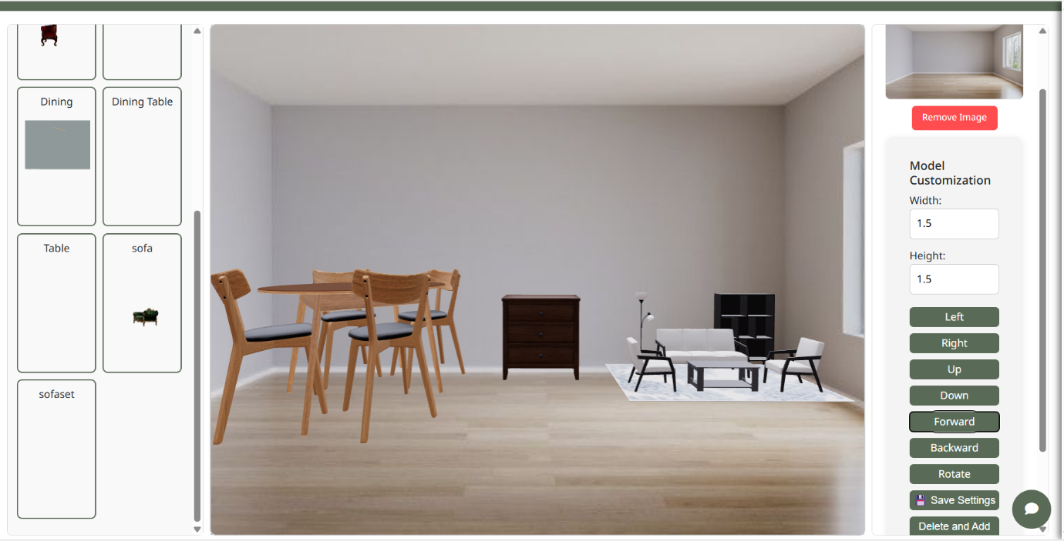

Slide 29
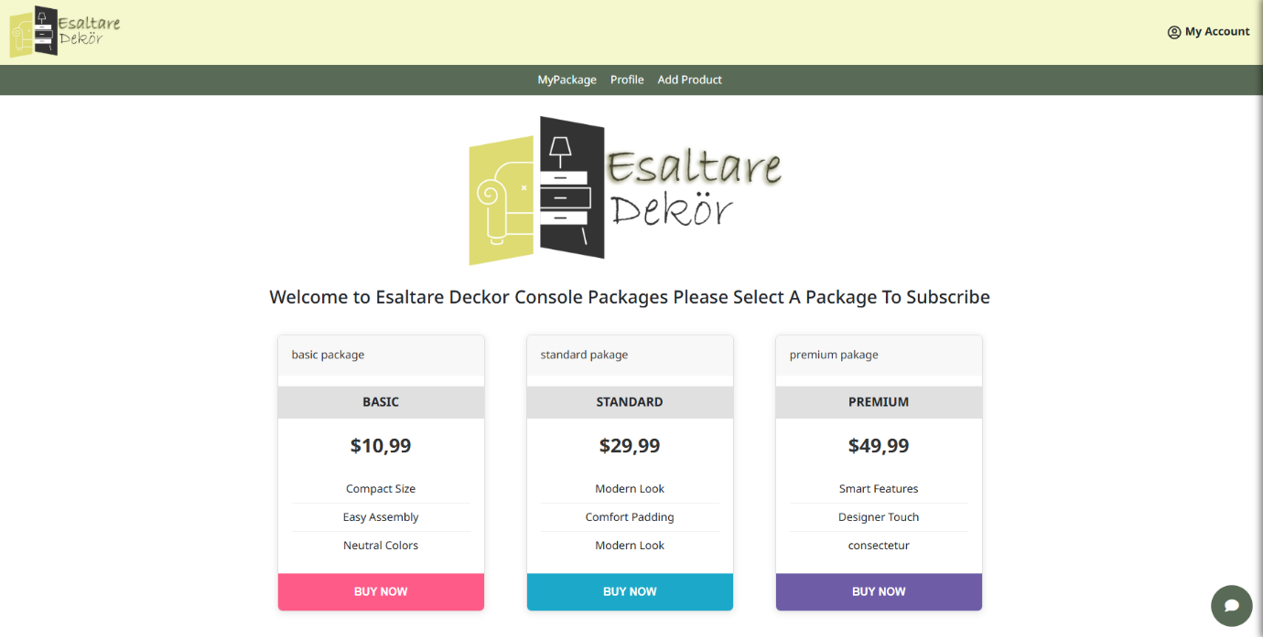

Slide 30
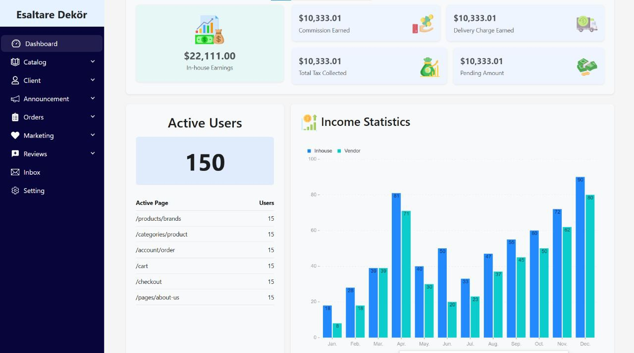

Slide 31
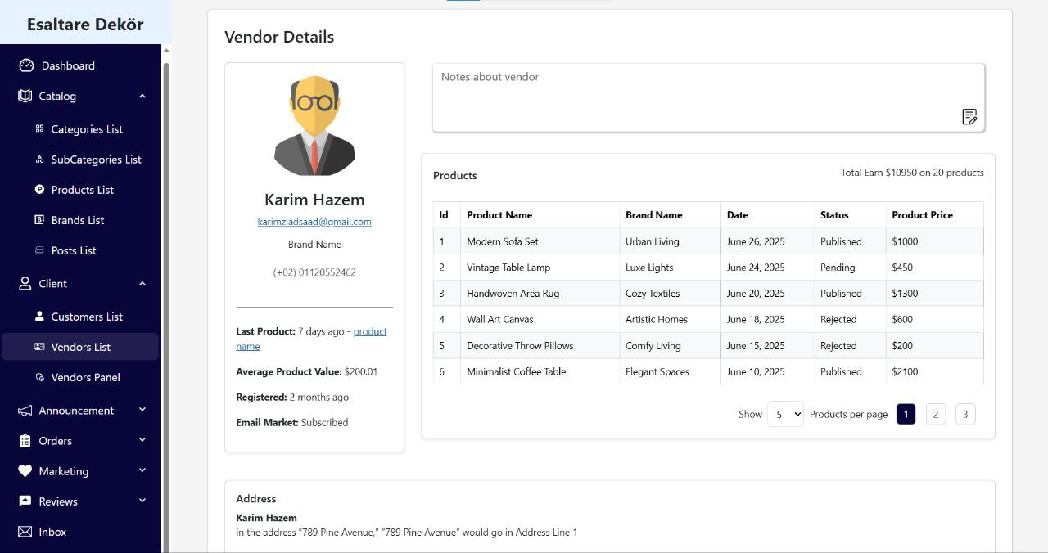

Slide 32
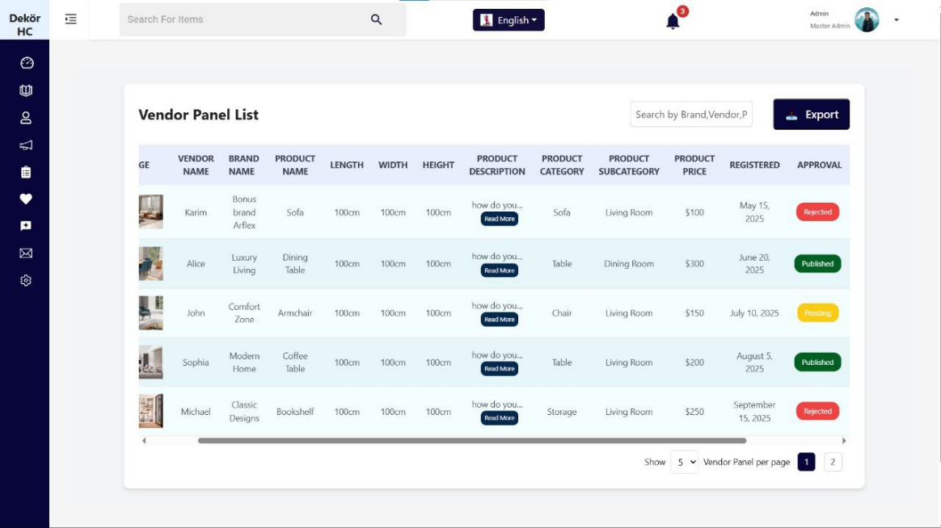

Slide 33
Thank You

